Slide 1
Chapter 2a: Operating-System Services

Slide 2
Outline
Operating System Services
User and Operating System-Interface
System Calls
System Services
Linkers and Loaders
Why Applications are Operating System Specific

Slide 3
Objectives
Identify services provided by an operating system
Illustrate how system calls are used to provide operating system services

Slide 4
Operating System Services
Operating systems provide an environment for execution of programs and services to programs and users
One set of operating-system services provides functions that are helpful to the user:
User interface - Almost all operating systems have a user interface (UI).
Varies between Command-Line (CLI), Graphics User Interface (GUI), touch-screen, Batch
Program execution - The system must be able to load a program into memory and to run that program, end execution, either normally or abnormally (indicating error)
I/O operations - A running program may require I/O, which may involve a file or an I/O device
.

Slide 5
Operating System Services (Cont.)
One set of operating-system services provides functions that are helpful to the user (Cont.):
File-system manipulation - The file system is of particular interest. Programs need to read and write files and directories, create and delete them, search them, list file Information, permission management.
Communications – Processes may exchange information, on the same computer or between computers over a network
Communications may be via shared memory or through message passing (packets moved by the OS)

Slide 6
Operating System Services (Cont.)
One set of operating-system services provides functions that are helpful to the user (Cont.):
Error detection – OS needs to be constantly aware of possible errors
May occur in the CPU and memory hardware, in I/O devices, in user program
For each type of error, OS should take the appropriate action to ensure correct and consistent computing
Debugging facilities can greatly enhance the user’s and programmer’s abilities to efficiently use the system

Slide 7
Operating System Services (Cont.)
Another set of OS function exists for ensuring the efficient operation of the system itself via resource sharing
Resource allocation - When multiple users or multiple jobs running concurrently, resources must be allocated to each of them
Many types of resources - CPU cycles, main memory, file storage, I/O devices.
Logging - To keep track of which users use how much and what kinds of computer resources
Protection and security - The owners of information stored in a multiuser or networked computer system may want to control use of that information, concurrent processes should not interfere with each other
Protection involves ensuring that all access to system resources is controlled
Security of the system from outsiders requires user authentication, extends to defending external I/O devices from invalid access attempts

Slide 8
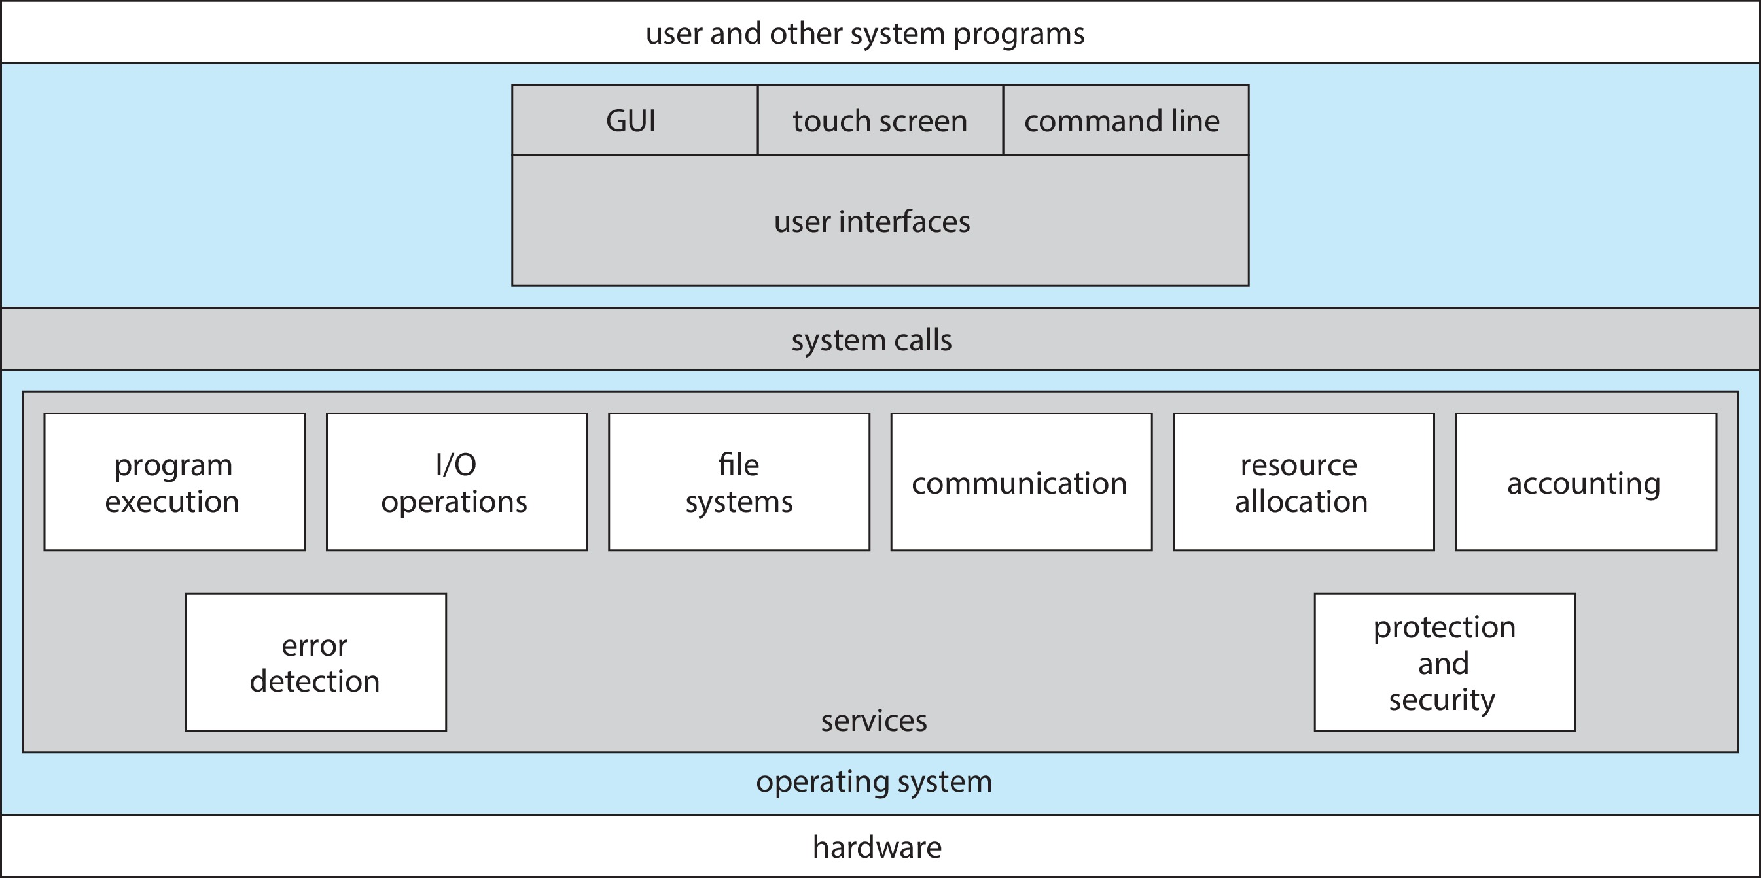
A View of Operating System Services

Slide 9
User Operating System Interface
CLI -- command line interpreter
allows direct command entry
GUI – graphical user interface
Touchscreen Interfaces
Batch

Slide 10
CLI
Sometimes implemented in kernel, sometimes by systems program
Sometimes multiple flavors implemented – shells
Primarily fetches a command from user and executes it
Sometimes commands built-in, sometimes just names of programs
If the latter, adding new features doesn’t require shell modification

Slide 11
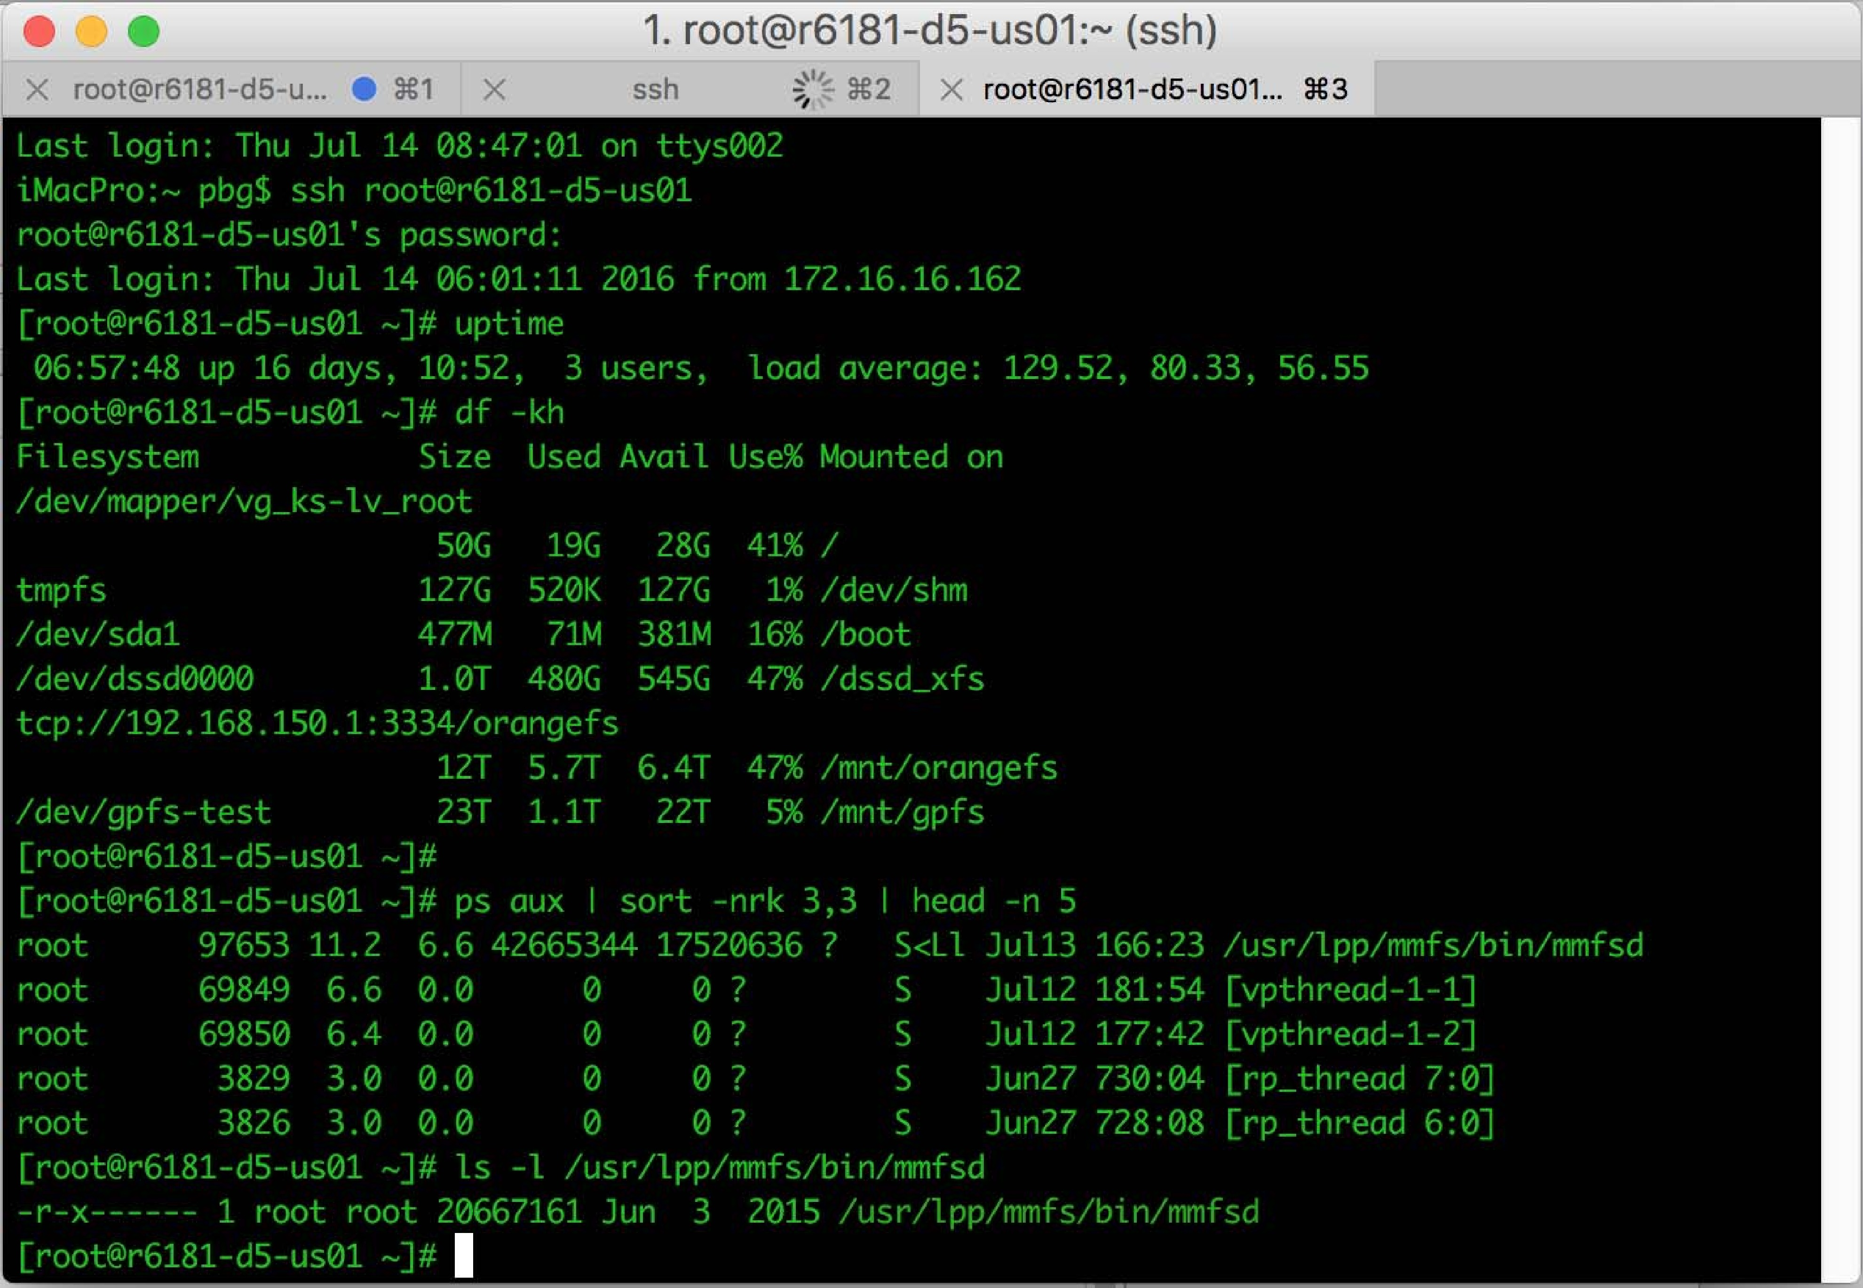
Bourne Shell Command Interpreter

Slide 12
GUI
User-friendly desktop metaphor interface
Usually mouse, keyboard, and monitor
Icons represent files, programs, actions, etc.
Various mouse buttons over objects in the interface cause various actions (provide information, options, execute function, open directory (known as a folder)
Invented at Xerox PARC
Many systems now include both CLI and GUI interfaces
Microsoft Windows is GUI with CLI “command” shell
Apple Mac OS X is “Aqua” GUI interface with UNIX kernel underneath and shells available
Unix and Linux have CLI with optional GUI interfaces (CDE, KDE, GNOME)

Slide 13
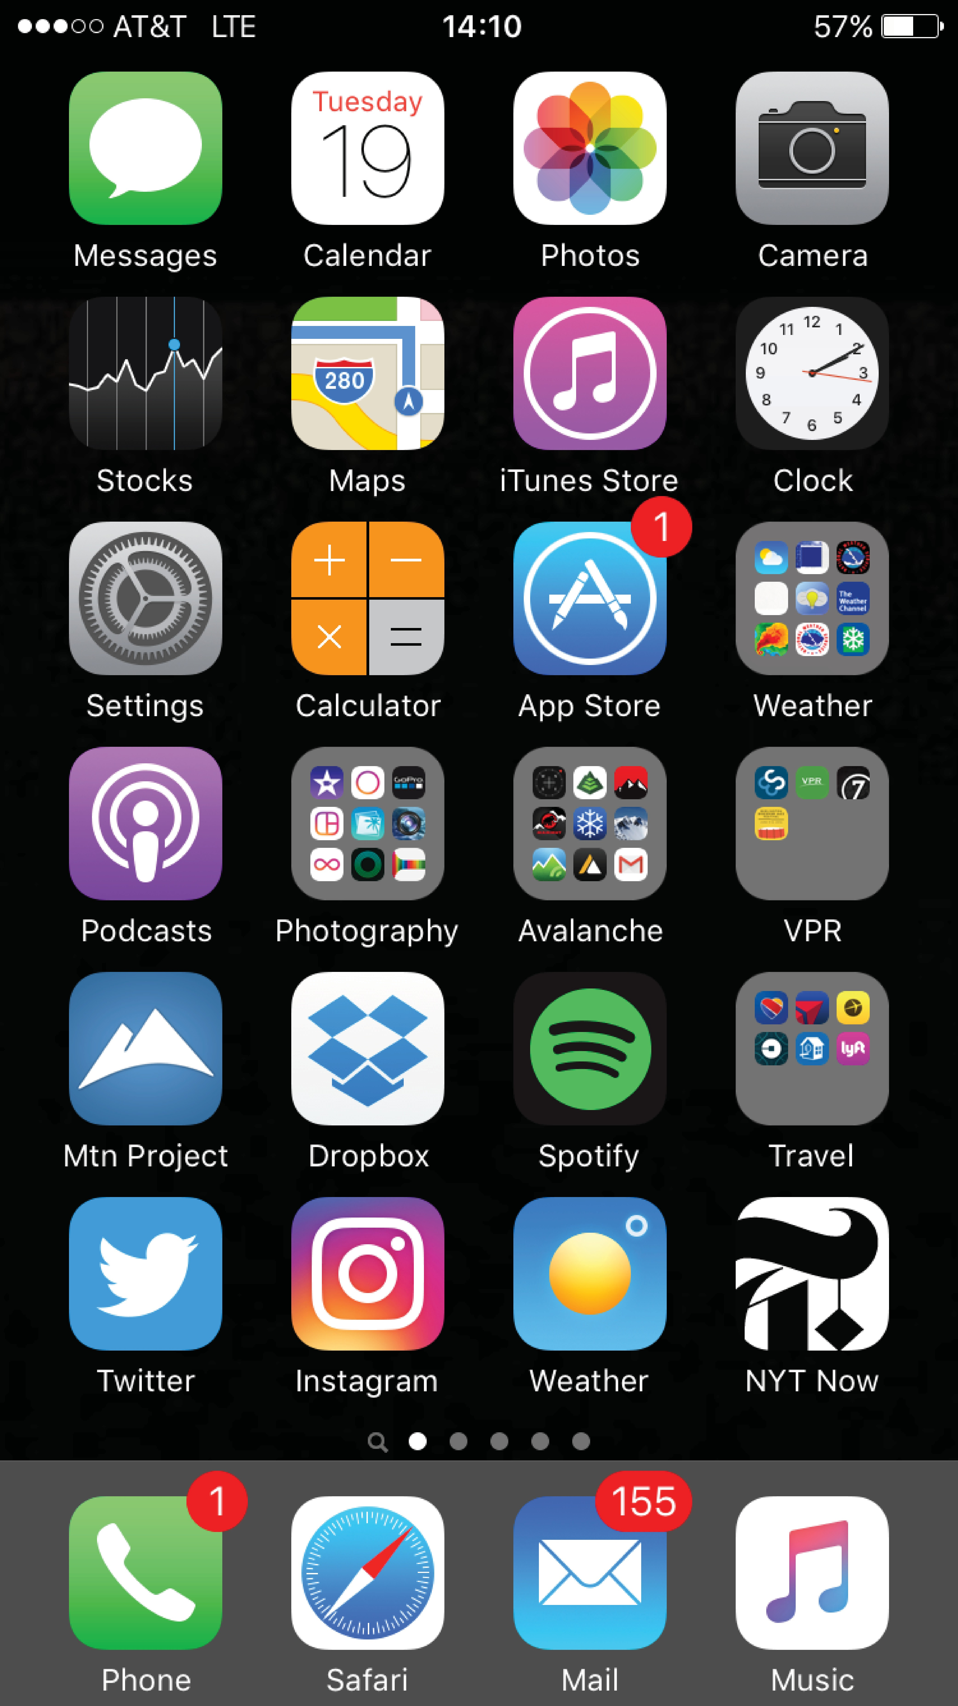
Touchscreen Interfaces
Touchscreen devices require new interfaces
Mouse not possible or not desired
Actions and selection based on gestures
Virtual keyboard for text entry
Voice commands

Slide 14
The Mac OS X GUI

Slide 15
System Calls
Programming interface to the services provided by the OS
Typically written in a high-level language (C or C++)
Mostly accessed by programs via a high-level Application Programming Interface (API) rather than direct system call use
Three most common APIs are Win32 API for Windows, POSIX API for POSIX-based systems (including virtually all versions of UNIX, Linux, and Mac OS X), and Java API for the Java virtual machine (JVM)
Note that the system-call names used throughout this text are generic

Slide 16
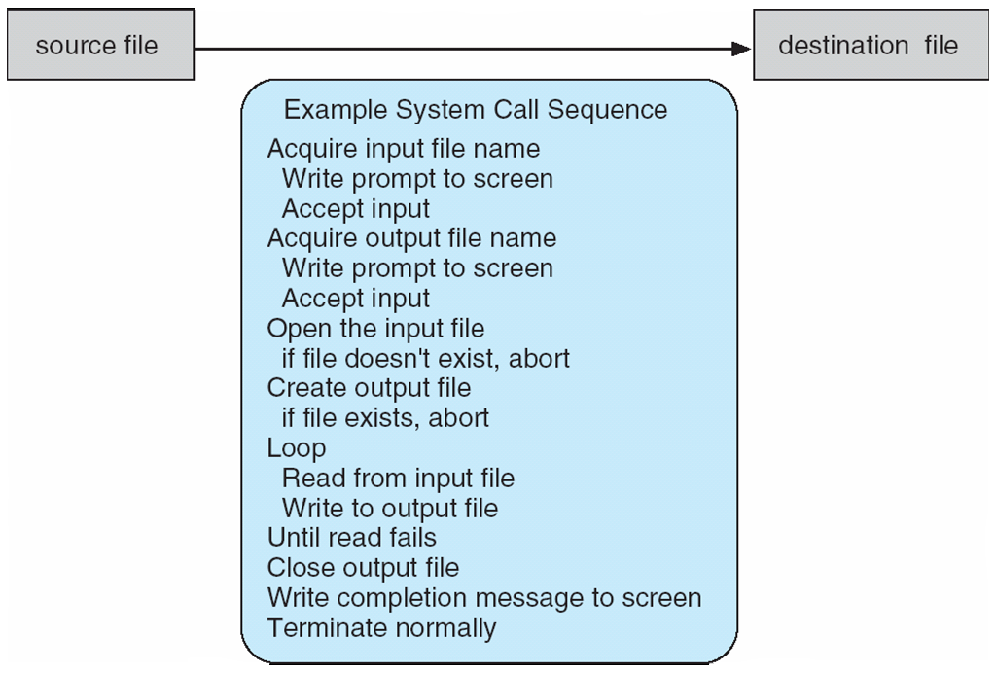
Example of System Calls
System call sequence to copy the contents of one file to another file

Slide 17
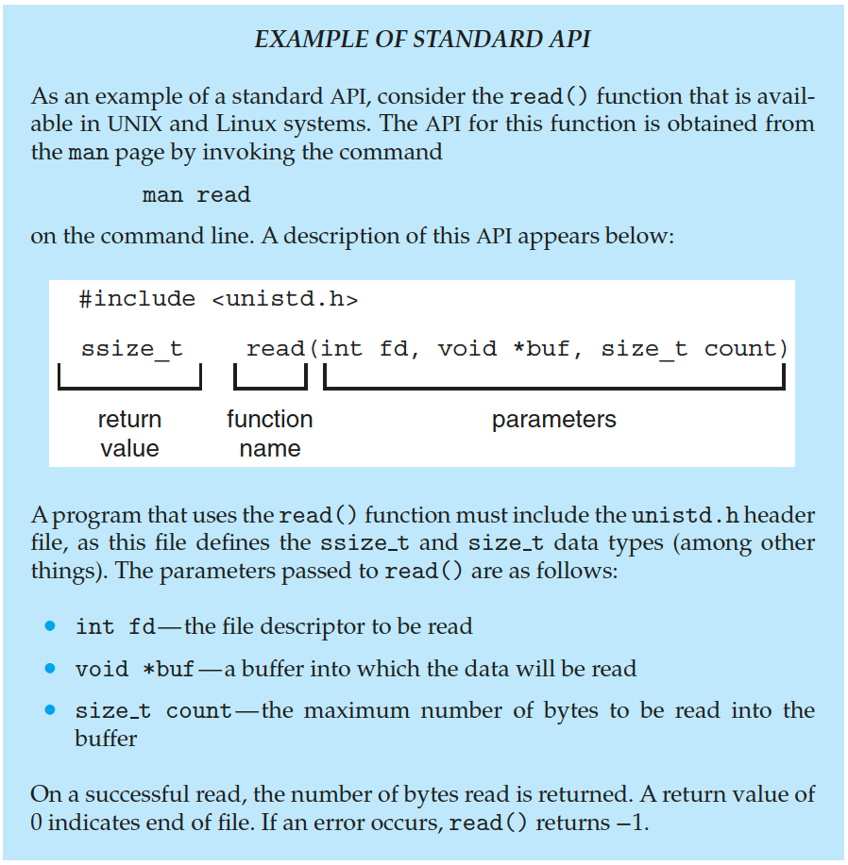
Example of Standard API

Slide 18
System Call Implementation
Typically, a number is associated with each system call
System-call interface maintains a table indexed according to these numbers
The system call interface invokes the intended system call in OS kernel and returns status of the system call and any return values
The caller need not know anything about how the system call is implemented
Just needs to obey API and understand what OS will do as a result call
Most details of OS interface hidden from programmer by API
Managed by run-time support library (set of functions built into libraries included with compiler)

Slide 19
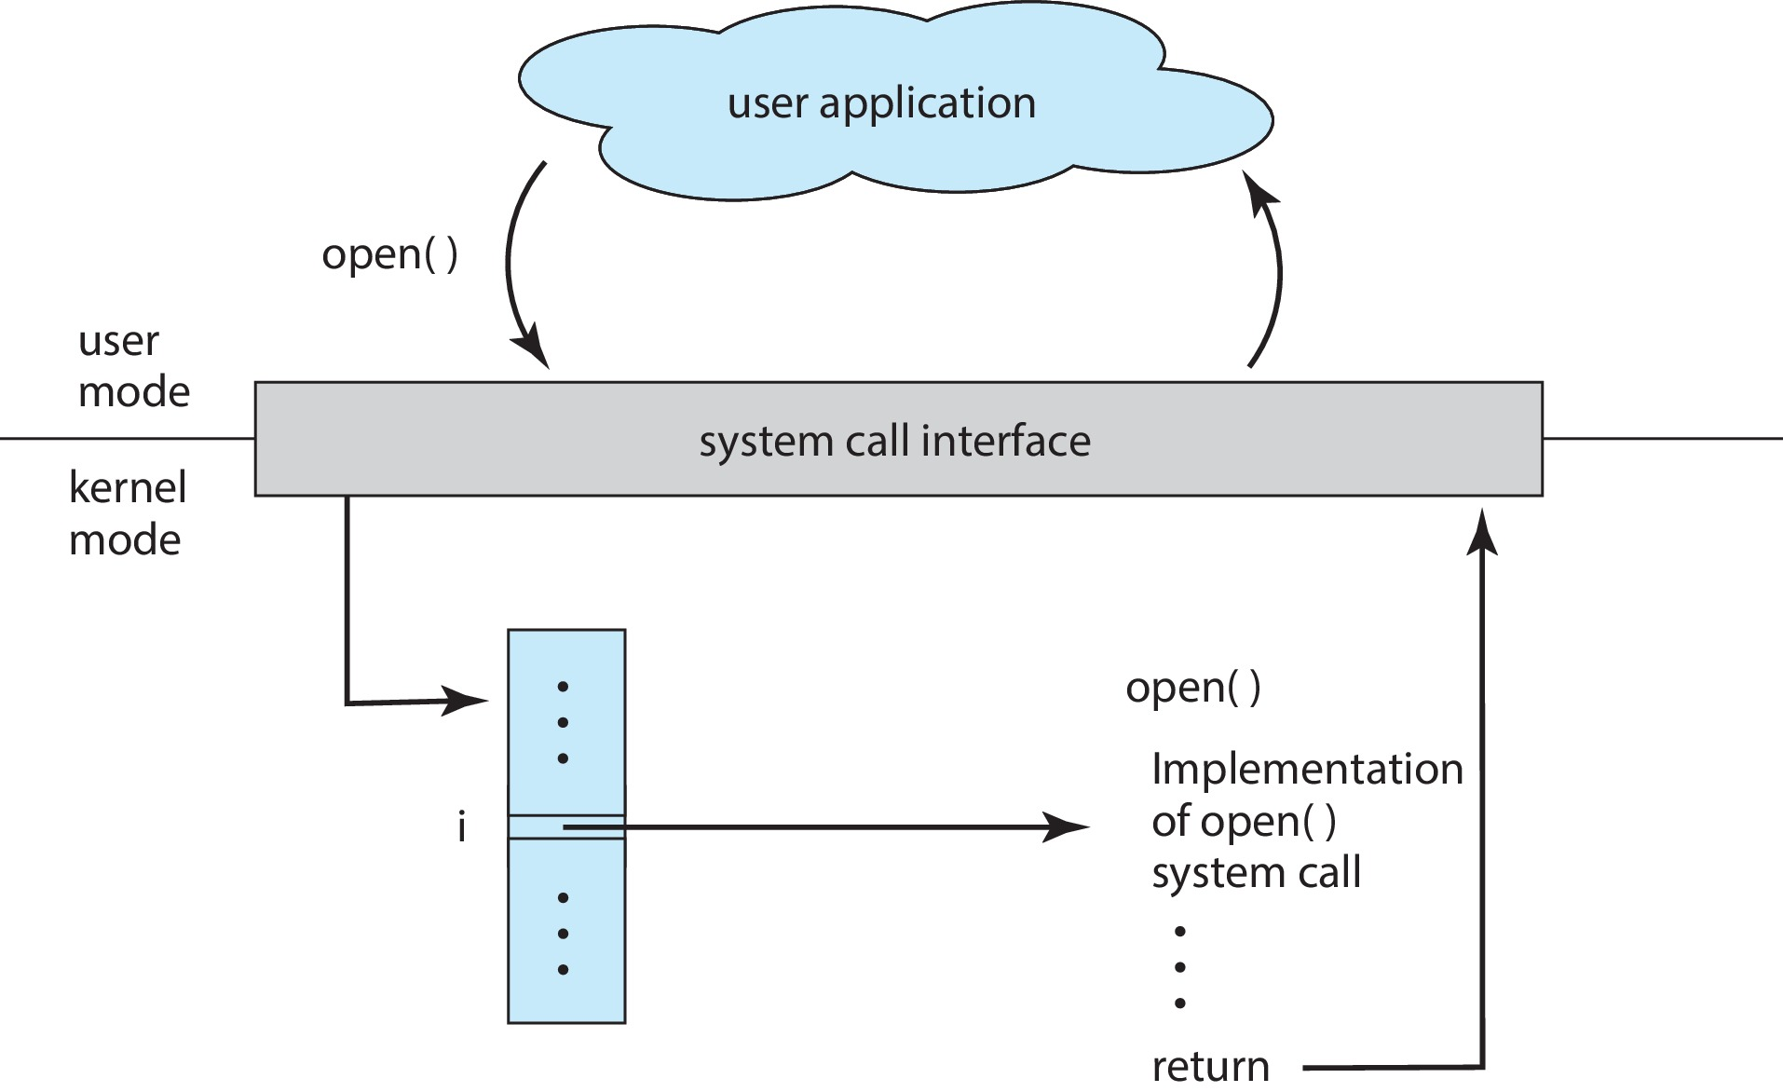
API: System Call to Open a File

Slide 20
System Call Parameter Passing
Often, more information is required than simply identity of desired system call
Exact type and amount of information vary according to OS and call
Three general methods used to pass parameters to the OS
Pass the parameters in registers
In some cases, there may be more parameters than registers
Parameters stored in a block, or table, in memory, and address of block passed as a parameter in a register
This approach taken by Linux and Solaris
Parameters placed, or pushed, onto the stack by the program and popped off the stack by the operating system
Block and stack methods do not limit the number or length of parameters being passed

Slide 21
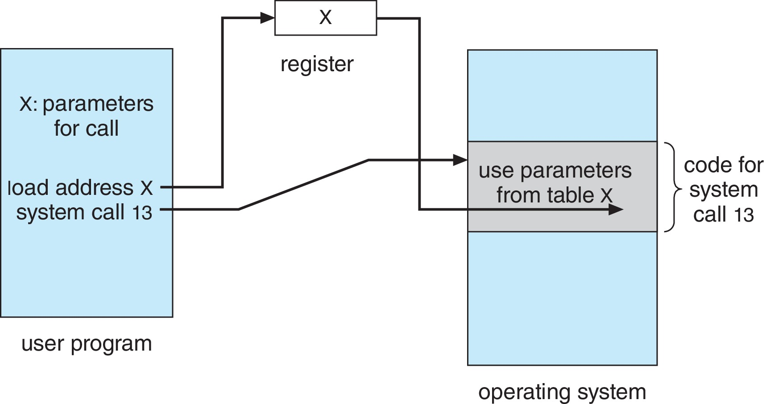
Parameter Passing via Table

Slide 22
Types of System Calls
Process control
create process, terminate process
end, abort
load, execute
get process attributes, set process attributes
wait for time
wait event, signal event
allocate and free memory
dump memory if error
Debugger for determining bugs, single step execution
Locks for managing access to shared data between processes

Slide 23
Types of System Calls (Cont.)
File management
create file, delete file
open, close file
read, write, reposition
get and set file attributes
Device management
request device, release device
read, write, reposition
get device attributes, set device attributes
logically attach or detach devices

Slide 24
Types of System Calls (Cont.)
Information maintenance
get time or date, set time or date
get system data, set system data
get and set process, file, or device attributes
Communications
create, delete communication connection
send, receive messages if message passing model to host name or process name
From client to server
shared-memory model create and gain access to memory regions
transfer status information
attach and detach remote devices

Slide 25
Types of System Calls (Cont.)
Protection
control access to resources
get and set permissions
allow and deny user access

Slide 26
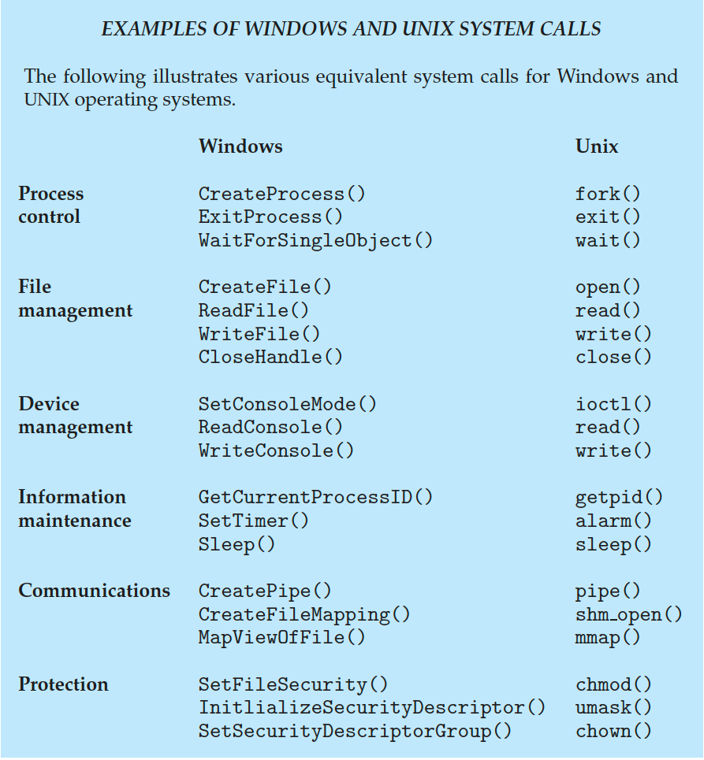
Examples of Windows and Unix System Calls

Slide 27
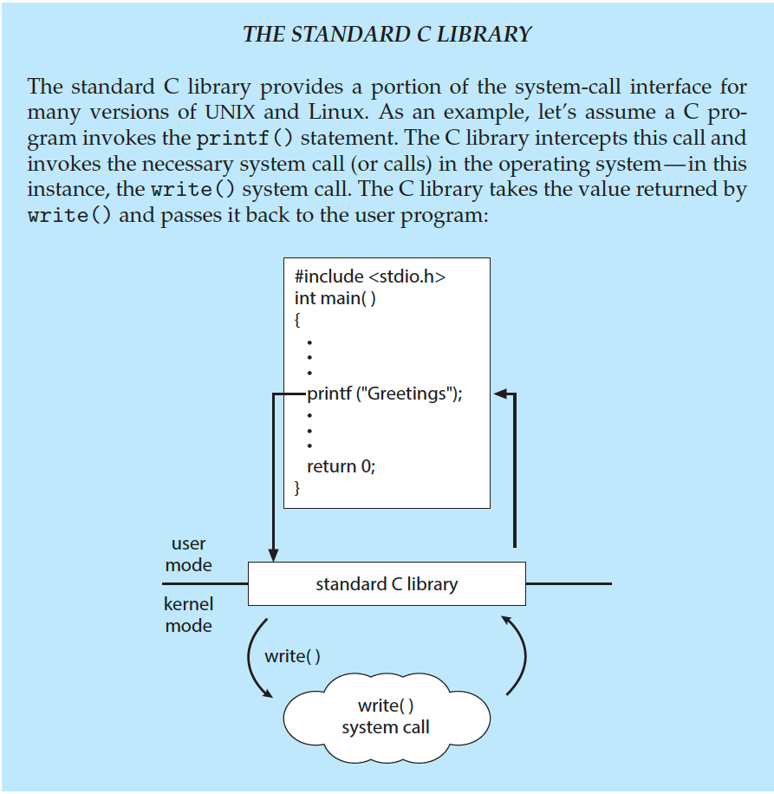
Standard C Library Example
C program invoking printf() library call, which calls write() system call

Slide 28
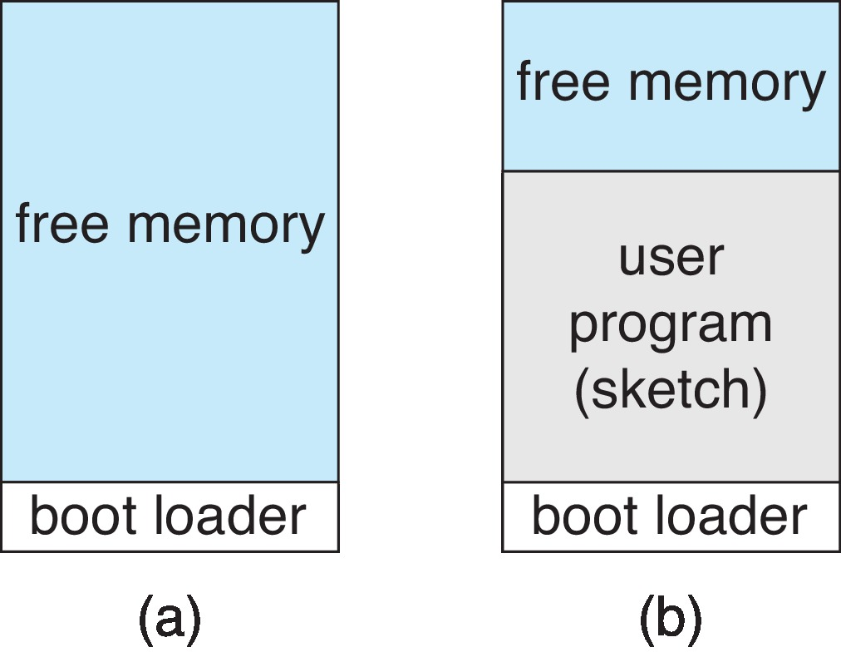
Example: Arduino
The Arduino is a simple hardware platform consisting of a microcontroller along with input sensors that respond to a variety of events, such as changes to light, temperature, and barometric pressure, etc.
Single-tasking
No operating system
Programs (sketch) loaded via USB into flash memory
Single memory space
Boot loader loads program
Program exit -> shell reloaded
At system startup running a program

Slide 29
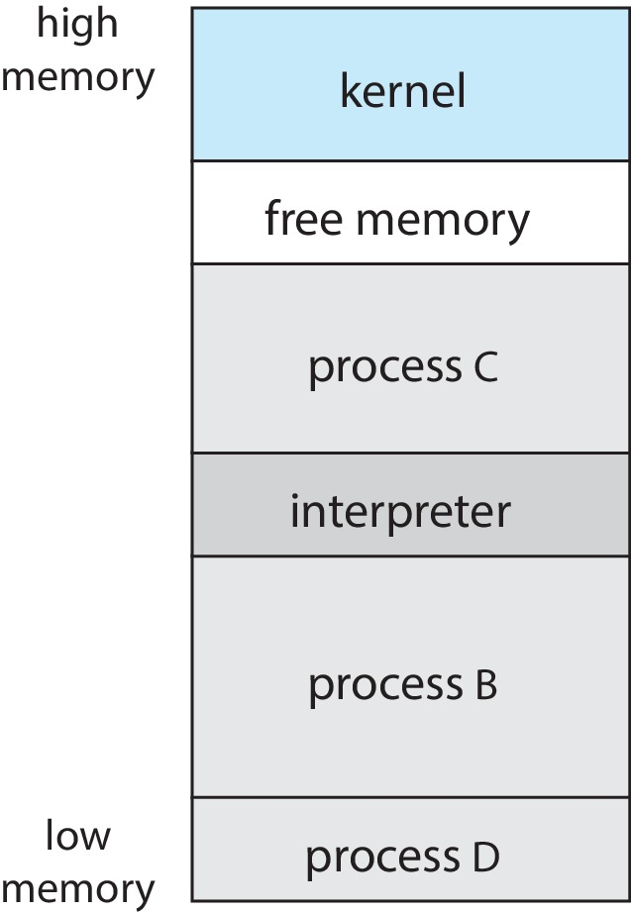
Example: FreeBSD
Unix variant
Multitasking
User login -> invoke user’s choice of shell
Shell executes fork() system call to create process
Executes exec() to load program into process
Shell waits for process to terminate or continues with user commands
Process exits with:
code = 0 – no error
code > 0 – error code

Slide 30
System Services
System programs provide a convenient environment for program development and execution. They can be divided into:
File manipulation
Status information sometimes stored in a file
Programming language support
Program loading and execution
Communications
Background services
Application programs
Most users’ view of the operation system is defined by system programs, not the actual system calls

Slide 31
System Services (Cont.)
Provide a convenient environment for program development and execution
Some of them are simply user interfaces to system calls; others are considerably more complex
File management - Create, delete, copy, rename, print, dump, list, and generally manipulate files and directories
Status information
Some ask the system for info - date, time, amount of available memory, disk space, number of users
Others provide detailed performance, logging, and debugging information
Typically, these programs format and print the output to the terminal or other output devices
Some systems implement a registry - used to store and retrieve configuration information

Slide 32
System Services (Cont.)
File modification
Text editors to create and modify files
Special commands to search contents of files or perform transformations of the text
Programming-language support - Compilers, assemblers, debuggers and interpreters sometimes provided
Program loading and execution- Absolute loaders, relocatable loaders, linkage editors, and overlay-loaders, debugging systems for higher-level and machine language
Communications - Provide the mechanism for creating virtual connections among processes, users, and computer systems
Allow users to send messages to one another’s screens, browse web pages, send electronic-mail messages, log in remotely, transfer files from one machine to another

Slide 33
System Services (Cont.)
Background Services
Launch at boot time
Some for system startup, then terminate
Some from system boot to shutdown
Provide facilities like disk checking, process scheduling, error logging, printing
Run in user context not kernel context
Known as services, subsystems, daemons
Application programs
Don’t pertain to system
Run by users
Not typically considered part of OS
Launched by command line, mouse click, finger poke

Slide 34
Linkers and Loaders
Source code compiled into object files designed to be loaded into any physical memory location – relocatable object file
Linker combines these into single binary executable file
Also brings in libraries
Program resides on secondary storage as binary executable
Must be brought into memory by loader to be executed
Relocation assigns final addresses to program parts and adjusts code and data in program to match those addresses
Modern general-purpose systems don’t link libraries into executables
Rather, dynamically linked libraries (in Windows, DLLs) are loaded as needed, shared by all that use the same version of that same library (loaded once)
Object, executable files have standard formats, so operating system knows how to load and start them

Slide 35
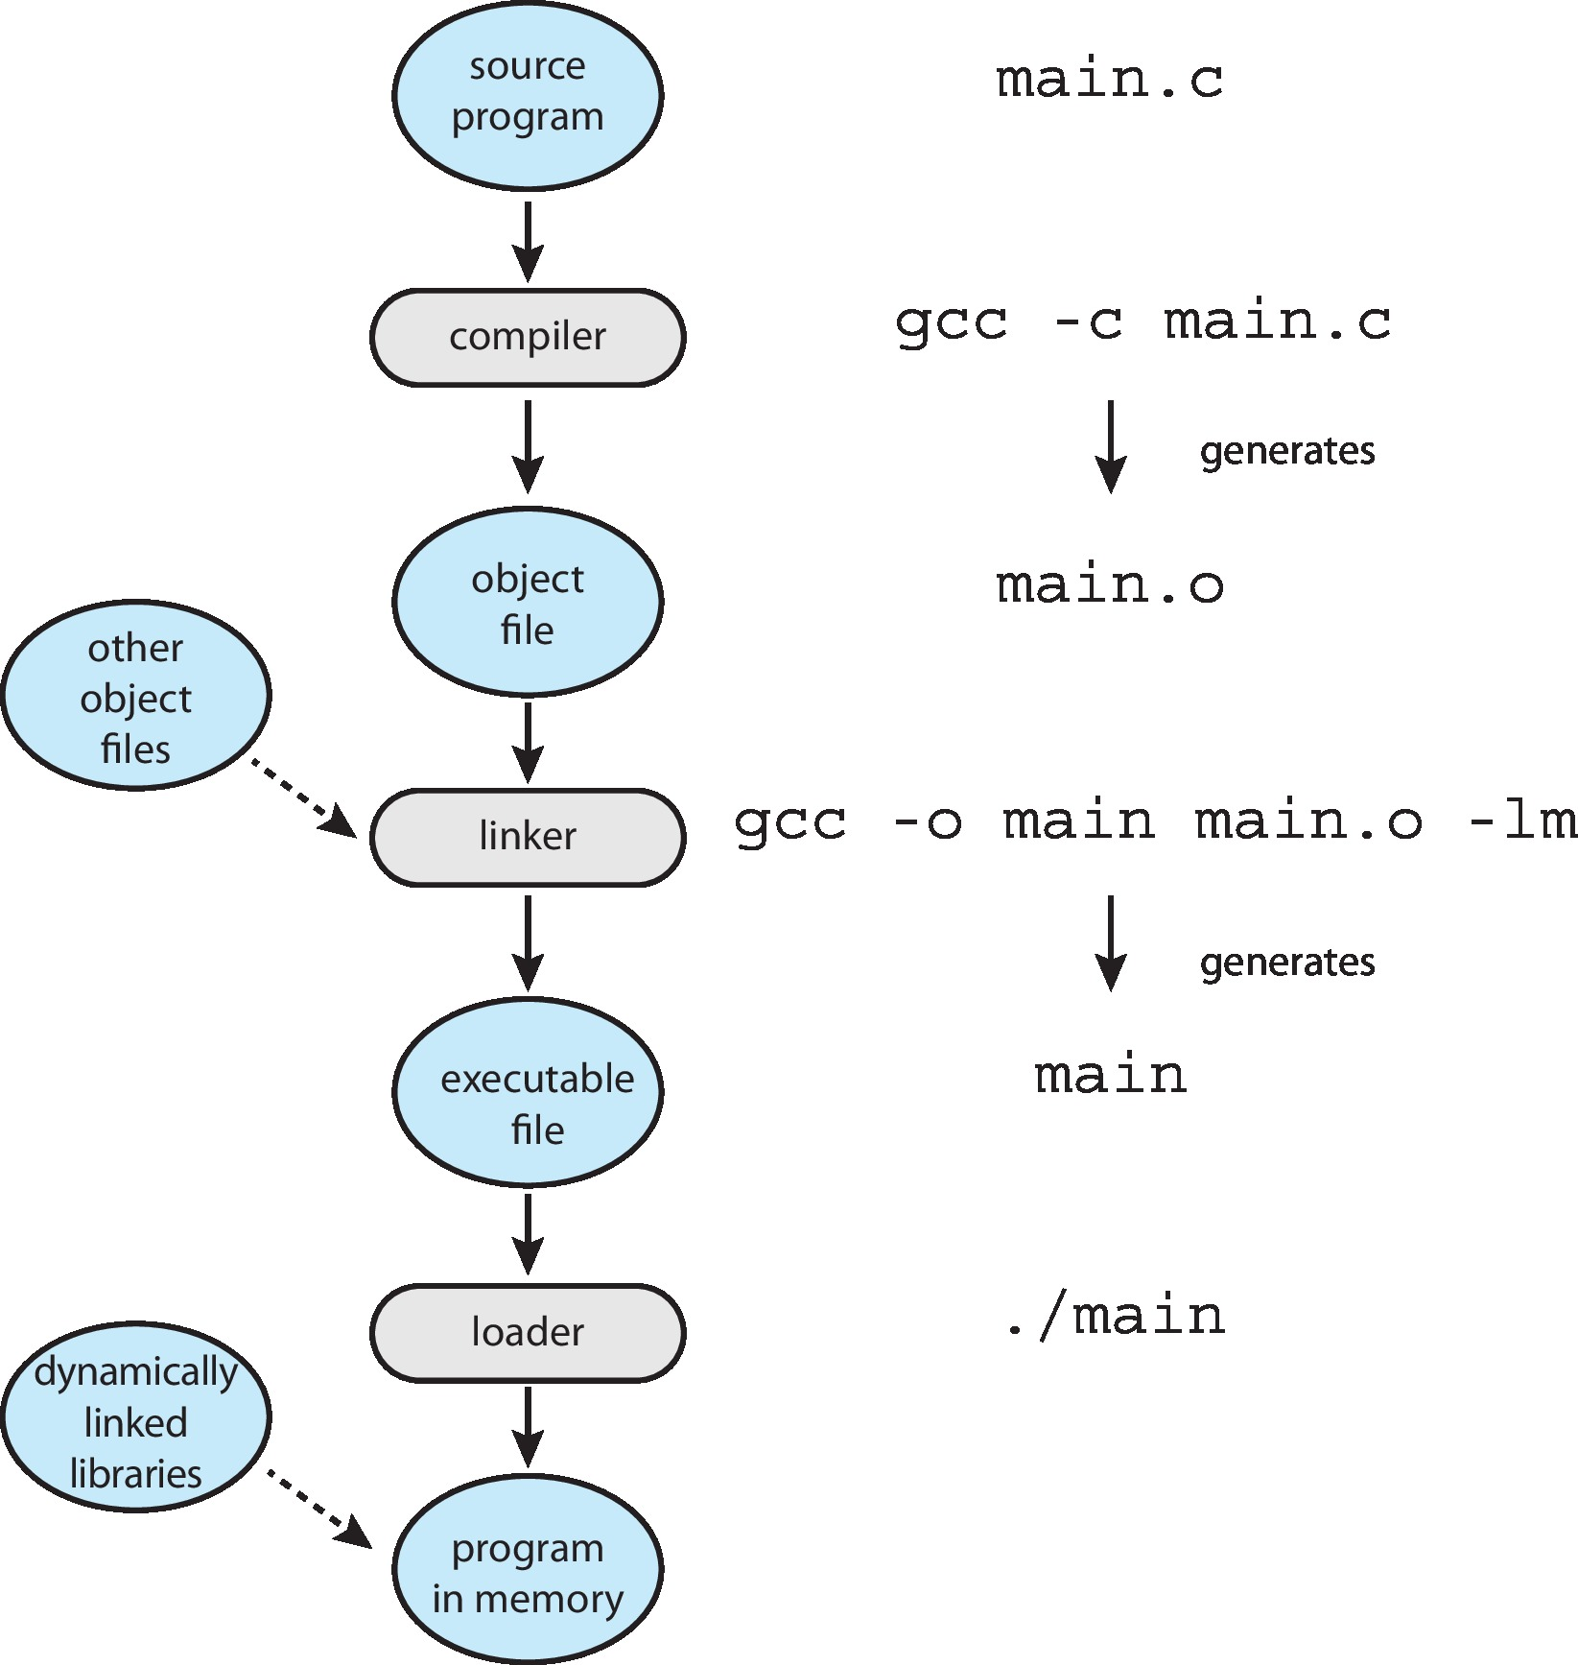
The Role of the Linker and Loader

Slide 36
Why Applications are Operating System Specific
Apps compiled on one system usually not executable on other operating systems
Each operating system provides its own unique system calls
Own file formats, etc.
Apps can be multi-operating system
Written in interpreted language like Python, Ruby, and interpreter available on multiple operating systems
App written in language that includes a VM containing the running app (like Java)
Use standard language (like C), compile separately on each operating system to run on each
Application Binary Interface (ABI) is architecture equivalent of API, defines how different components of binary code can interface for a given operating system on a given architecture, CPU, etc.

Slide 37
End of Chapter 2a

